Slide 1
William Myers
Bill is the Senior Director of Hydrogen Projects for Mitsubishi Power – Americas. He is a graduate of the University of Minnesota (BSME) and spent the first 26 years of his career working for companies in Minneapolis on municipal and power facility projects. He joined Mitsubishi Power in 2013 to continue building power plants in North and South America and has spent the past 2 years on a team conducting the company’s FEED and validation efforts on hydrogen generation. Bill moved to Florida in 2014 with his wife and two daughters who will soon both be in college (FSU and Emerson). He was able to play a lot more golf in Minnesota than he has in Florida so maybe that will change now.

Slide 2
Hydrogen for Power Generation:
Excel Engineering 2022 Technical Conference
William Myers
Senior Director – Hydrogen Projects Mitsubishi Power
© 2020 Mitsubishi Power Americas, Inc. All Rights Reserved.

Slide 3
Hydrogen Basics and Safety
A look at the amount of hydrogen needed and considerations to use it safely and reliably
© 2020 Mitsubishi Power Americas, Inc. All Rights Reserved.

Slide 4
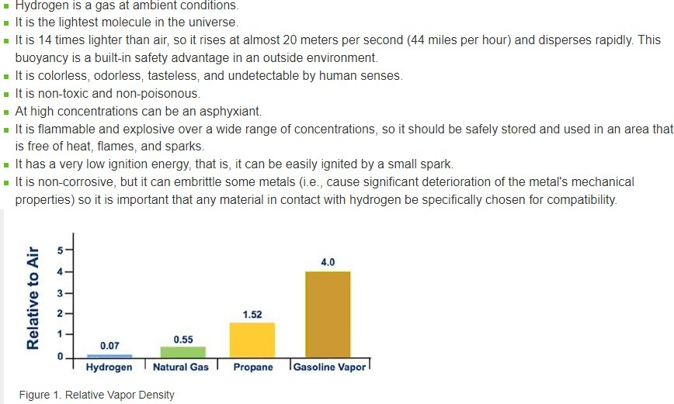
Gaseous Hydrogen Properties and Behaviors

Slide 5
LHV and HHV of Hydrogen and Natural Gas
Hydrogen has high energy by weight, but lower energy by volume (approx. 1/3 of Natural Gas heating value)
These facts drive storage and transport considerations
Fuels | Lower Heating Value (LHV) [1] |  |  | Higher Heating Value (HHV) [1] |  |  | Density
Gaseous Fuels @ 32 F and 1 atm | Btu/ft3 [2] | Btu/lb [3] | MJ/kg [4] | Btu/ft3 [2] | Btu/lb [3] | MJ/kg [4] | grams/ft3
Natural gas | 983 | 20,267 | 47.141 | 1089 | 22,453 | 52.225 | 22.0
Hydrogen | 290 | 51,682 | 120.21 | 343 | 61,127 | 142.18 | 2.55
Notes:
[1] The lower heating value (also known as net calorific value) of a fuel is defined as the amount of heat released by combusting a specified quantity (initially at 25°C) and returning the temperature of the combustion products to 150°C, which assumes the latent heat of vaporization of water in the reaction products is not recovered.
The higher heating value (also known as gross calorific value or gross energy) of a fuel is defined as the amount of heat released by a specified quantity (initially at 25°C) once it is combusted and the products have returned to a temperature of 25°C, which takes into account the latent heat of vaporization of water in the combustion products.
[2] Btu = British thermal unit.
[3] The heating values for gaseous fuels in units of Btu/lb are calculated based on the heating values in units of Btu/ft3 and the corresponding fuel density values. The heating values for liquid fuels in units of Btu/lb are calculated based on heating values in units of Btu/gal and the corresponding fuel density values.
[4] The heating values in units of MJ/kg, are converted from the heating values in units of Btu/lb.
Data Source: H2 Tools website, maintained by the Pacific Northwest National Laboratory with funding from the DOE Office of Energy Efficiency and Renewable Energy's Hydrogen and Fuel Cell Technologies Office.

Slide 6
Hydrogen – Some Numbers to Remember
Hydrogen Production from Water Electrolysis (~5 kWh/Nm³ H₂)
Electrolyzer Power: 1 MW ↔ 200 Nm³/h H₂ ↔ ~18 kg/h H₂ = 430 kg/day H₂
Production Energy: 55 kWh of electricity → 1 kg H₂ ↔ 11.1 Nm³ ↔ requires ~ 10 liters [2.2 gallons] demineralized water
Cars, Buses, and Gas Turbines
FCEV * | H₂ Tank | H₂ Consumption | Driving Range | Annual Driving Distance | Annual H₂ Consumption
Car (passenger) | 5 kg | 1 kg/100 km | 500 km | 15.000 km | 150 kg
Bus (12 m) | 35 kg | 8 kg/100 km | 350 km | 60.000 km | 5 tons
Large Gas Turbine Combined Cycle Plant |  |  |  |  | 31,000 tons
* FCEV: Fuel Cell Electric Vehicle

Slide 7
Hydrogen Primary Governing Requirements
Hydrogen Projects with Production, Transportation and Subsurface Storage will generally need to meet:
Federal Safety Regulations:
OSHA Sections 4, 6, and 8; 29 CFR 1910.103 Subpart H – Hazardous Materials
U.S. DOT 49 CFR 171-179, 192 – Hazardous Materials Transportation
State Environmental Quality Regulations:
Air Emissions
Groundwater Quality
Local Land Use Ordinances:
Zoning and Conditional Uses
Building Inspection and Fire Safety Review
National Codes and Standards:
American National Standards Institute
American Petroleum Institute
American Society of Civil Engineers
American Society of Testing and Materials
American Society of Mechanical Engineers
Compressed Gas Association H and S Series
National Fire Protection Association Codes 1, 2, 55, 853
International Building Code
International Fire Code
International Mechanical Code
International Fuel Gas Code
Example Codes/Standards:
NFPA 2 - Hydrogen Technologies Code
NFPA 55 - Compressed Gases and Cryogenic Fluids Code
ASME – B31 - pressure vessels
NFPA 69 - Standard on Explosion Prevention Systems
ISO/TC197: Hydrogen Technologies
CGA S-1. 1-1.3 Pressure relief device design
The International Fire Code (IFC), 2009 edition
UL 61010-1: Safety Requirements for Electrical Equipment for Measurement, Control
IEC/TC 31: Equipment for explosive atmospheres
ISO 22734 - Hydrogen generators using water electrolysis (attached)
NREL Hydrogen Technologies Safety Guide (attached)
References:

Slide 8
Hydrogen Safety, Codes, and Standards: Established Regulatory Framework
Community & Environment
National Codes & Standards
Safe storage, use and handling in the workplace
Safe transportation in commerce
Federal Regulations
Engineering design, construction and operation controls
Employee, community, and environmental protections
Engineering Design & Construction
Operations Processes & Procedures
State Regulations
Local Ordinances & Permits
Existing H₂ Requirements are Comprehensive
Jurisdictional Focus is SAFETY
Mitsubishi Power Participation in Hydrogen Industry Organizations
Center for Hydrogen Safety
Several ASME Technical Committees (including B31.12 Hydrogen Piping)
EPRI – Low Carbon Resource Initiative (LCRI)
Electrolyzer, Delivery & Storage, Safety, and Renewable Fuels technical subcommittees
NFPA Technical Committees

Slide 9
Hydrogen Market Dynamics
Green hydrogen is not a power generation fuel, it is an energy storage medium
© 2020 Mitsubishi Power Americas, Inc. All Rights Reserved.

Slide 10
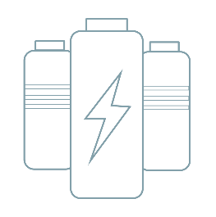
PHASE 1
Power Grid Decarbonization
The retirement and replacement
of coal-fired power plants with:
Different geographies will navigate the phases at different periods
Natural Gas
Renewables
PHASE 2
Tackle long-term intermittency,
currently managed by natural gas power generation:
Energy Storage
Renewables

Slide 11
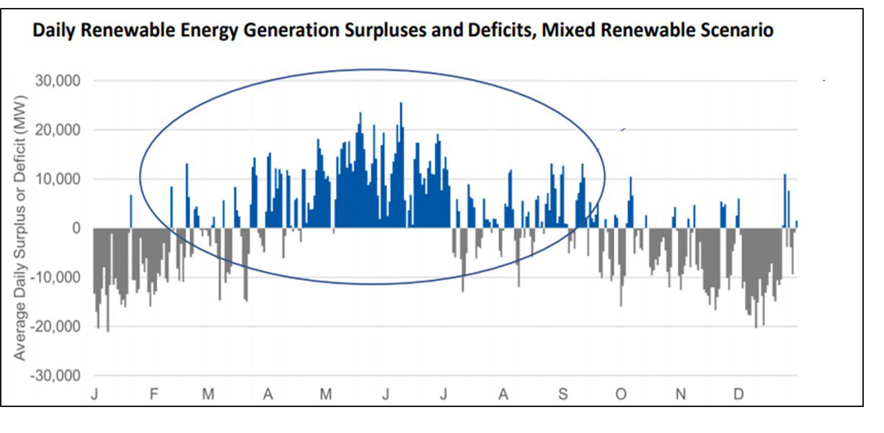
Surplus and Deficit Signal the Need for More Storage Options
CALIFORNIA WIND AND SOLAR CURTAILMENTS HIT RECORD HIGH IN APRIL 2020
CALIFORNIA SURPLUS AND DEFICIT PATTERNS UNDER A 100% RENEWABLE ENERGY SCENARIO
350,000
2017 2018 2019 2020
300,000
250,000
200,000
150,000
100,000
50,000
Renewable Energy Surplus
Megawatt hour (MWh)
Renewable Energy Deficit
-
Jan Feb Mar Apr May Jun Jul Aug Sep Oct Nov Dec
Source: Armonk Cohen Testimony
Source: CAISO, Data compiled July 2020
http://www.caiso.com/informed/Pages/ManagingOversupply.aspx
At just 30% renewable integration, peak monthly curtailment exceeds 300,000 MWh
Seasonal surplus and deficits signal need for long- duration energy storage “beyond the duck curve”

Slide 12
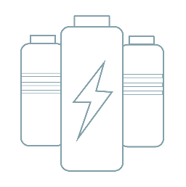
To Store Energy via Hydrogen or to Store via Lithium?
Comparison of Green Hydrogen Energy Storage Systems and Battery Energy Storage Systems
Electrolyzer
Salt Cavern, Pipeline, or Above Ground Vessel
Gas Turbine
Hydrogen for Long Duration Storage
Controls the charging rate (MW)
Controls the amount of energy stored (MWh)
Controls the discharging rate (MW)
Lithium Ion Battery for Short Duration Storage
Rectifier
Lithium Ion Battery
Inverter

Slide 13
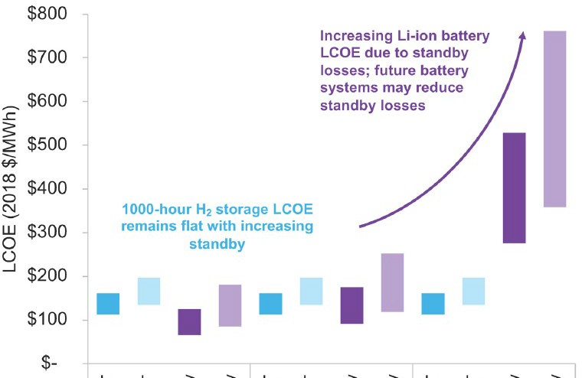
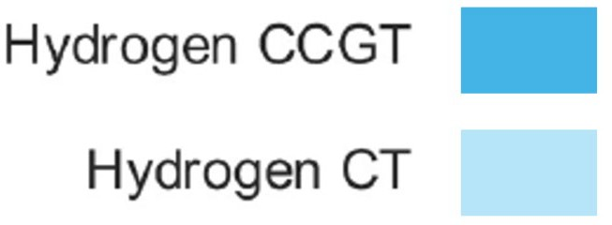
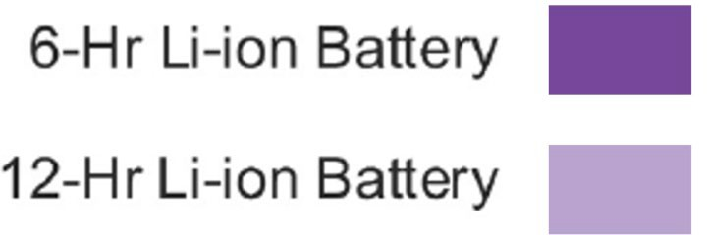
Economics of Storage
Standby Duration
Energy Storage System
Lithium Ion Batteries Ideal for Short Duration / Intra-Day Storage
Hydrogen Ideal for Long Duration / Inter-Day Storage

Slide 14
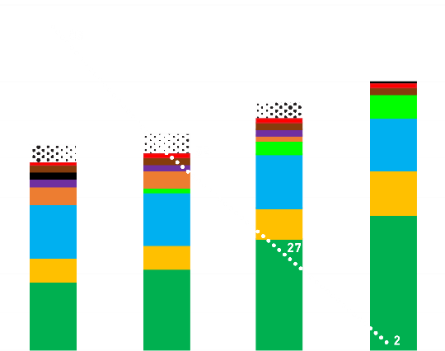
Integration of H2 Energy Storage Reduces Overall Cost of Net Zero
ENERGY ANALYSIS
Generation and Curtailment
Result with BESS Energy Storage Only
1800
1600
1400
1200
1000
800
600
400
200
0
2025 2030 2040 2050
Base
Result with BESS and H₂ Energy Storage
90
80
70
60
50
40
30
20
10
0
1800
1600
1400
1200
1000
800
600
400
200
0
90
80
70
60
50
40
30
20
10
0
CO₂ Emissions (mil Ton)
CO₂ Emissions (mil Ton)
Generation (TWh)
Generation (TWh)
2025
2030
2040
2050
Hydrogen

Slide 15
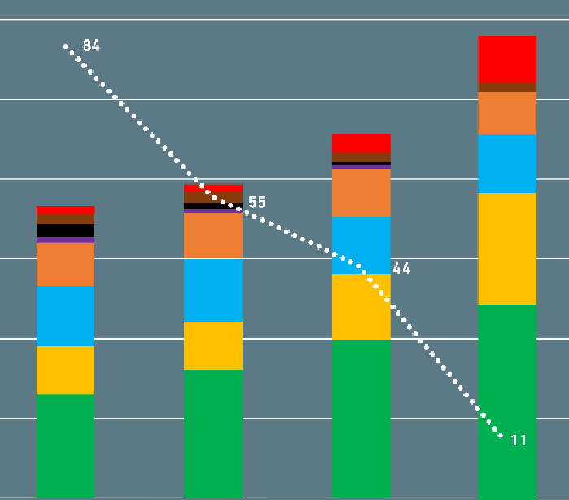
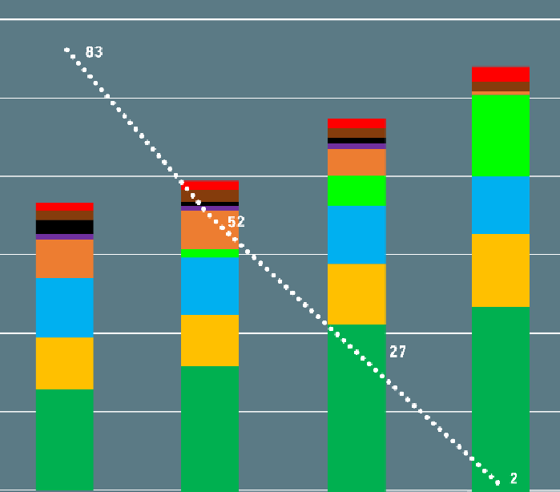
The Hydrogen Case Demonstrates Further Decarb Without Overbuild
CAPACITY ANALYSIS
Installed
Result with BESS Energy Storage Only Result with BESS and H₂ Energy Storage
600 90 600 90
80 80
500 500
70 70
CO₂ Emissions (mil Ton)
CO₂ Emissions (mil Ton)
Installed (GW)
400
60
50
40
Installed (GW)
400
60
50
40
300
300
200
30
20
200
30
20
100
100
10
10
0
0
0
0
2025 | 2030 | 2040 |  |  | 2030 | 2040 | 2050
2050
2025
Base
Hydrogen

Slide 16
Hydrogen Product Integration
Understanding and pulling together the entire H2 storage ecosystem (conversion + storage + GT)
© 2020 Mitsubishi Power Americas, Inc. All Rights Reserved.

Slide 17
Mitsubishi Power Diligence of Supply Chain
2019 - Preliminary Due Diligence of Electrolyzer OEMs
Technology assessment – Pressurized alkaline vs Atmospheric alkaline vs PEM
Pricing assessment – budgetary quotes for similarly scoped 20 MW / 4,000 Nm³/h design from various technology providers
Select vendor due diligence – In-person visit to China prior to COVID-19 outbreak December 2019
2020 – Detailed Due Diligence and Updated Scope
Refreshed proposals for 100-200MW “blocks” and engaged additional OEM’s
Hosted electrolyzer proposal review meetings with OEM’s and our Owner’s Engineer
Conducted evaluations based on levelized cost of hydrogen analysis, risk to Projects, and strategic supply chain considerations
Concluded Alkaline Electrolysis best option
FEED Study and Plant Design utilized pressurized electrolysis technology as design basis
2021 – Final Selection based on Final Scope
Refreshed RFP for firm pricing and bid spec based on interface points between OEM and ACES project
Finalized risk review and contingency planning for selection of OEM
Finalized negotiations with winning bidder

Slide 18
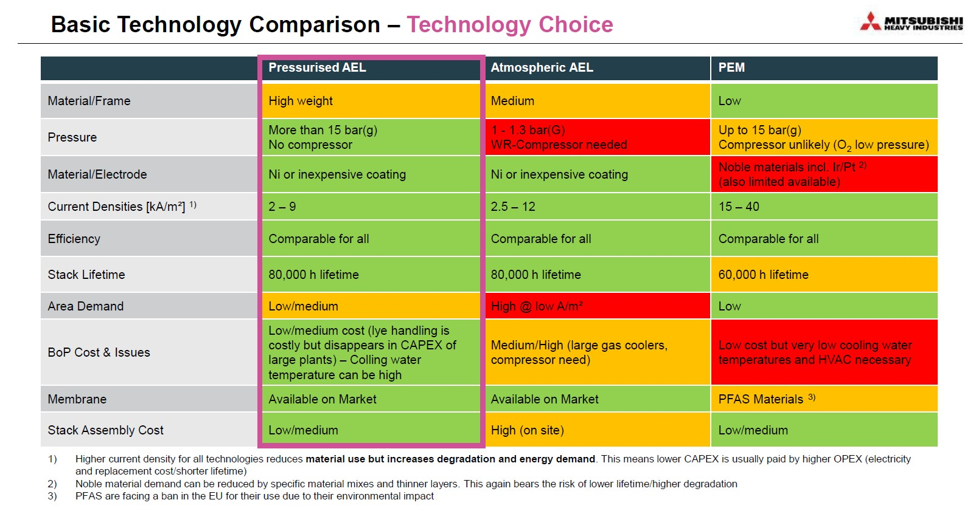

Slide 19
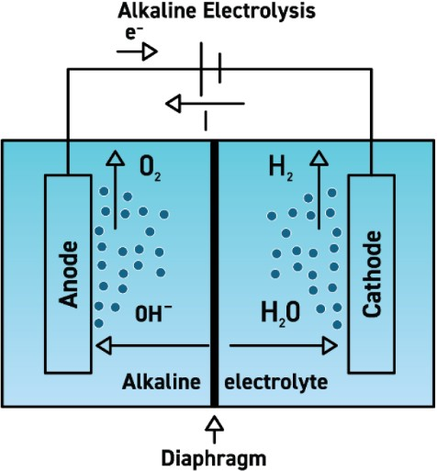
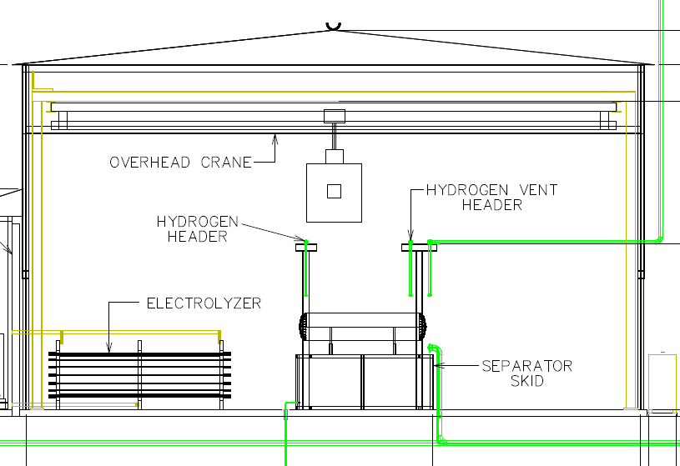
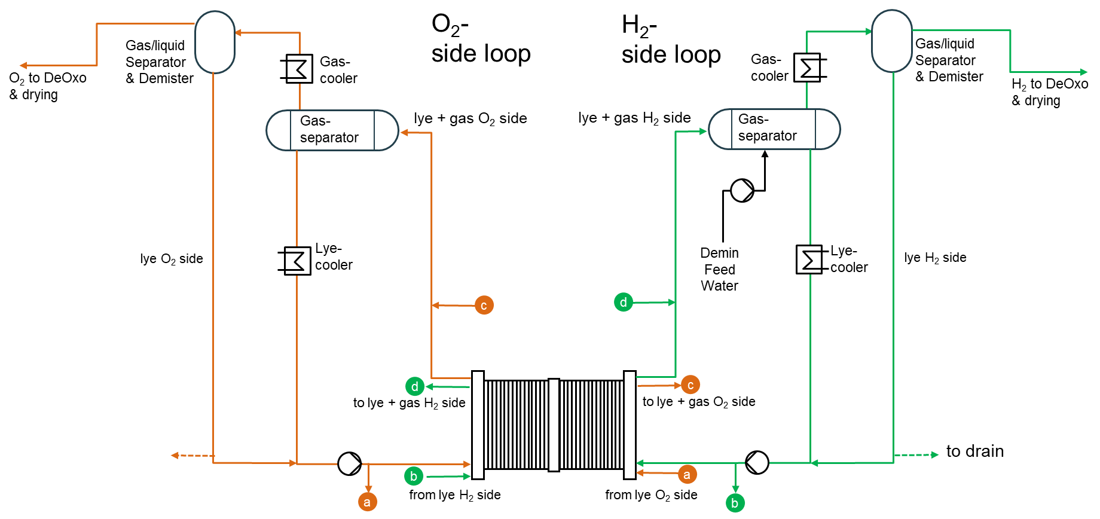
Pressurized Alkaline Electrolyzer Process
Steps:
The cell stack is full of lye solution (demineralized water mixed with an electrolyte to improve performance) as current is applied
Hydrogen gas is generated at the cathode side of the electrolyzer and exits via the hydrogen gas channel on the cathode cell plate:
4H₂O+4e == 2H₂+4OH-
Hydroxide diffuses through a membrane to the anode side creating oxygen which exits via the oxygen gas channel on the anode side of the cell plate:
4OH - == O₂+2H₂O+4e
Lye saturated hydrogen and oxygen gases are collected and piped to the gas conditioning skid where they are processed to reach base purity levels.
Lye solution is replenished to keep the stack full.
O₂ to header
H to header
2

Slide 20
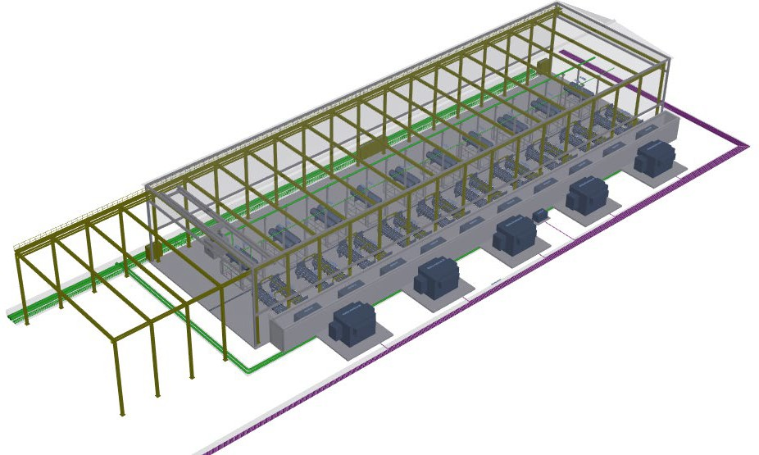
Hydrogen Facility: Building Overview (2 TPH / 110 MW)
Controls and Protection Systems
𝐻𝐻₂ Overhead Lines to Compressors
𝐻𝐻₂/𝑂𝑂₂ Gas Separator Skids
Rectifiers
Electrolyzers
Underground Electrical Supply Lines
Underground Utility Lines
Transformers

Slide 21
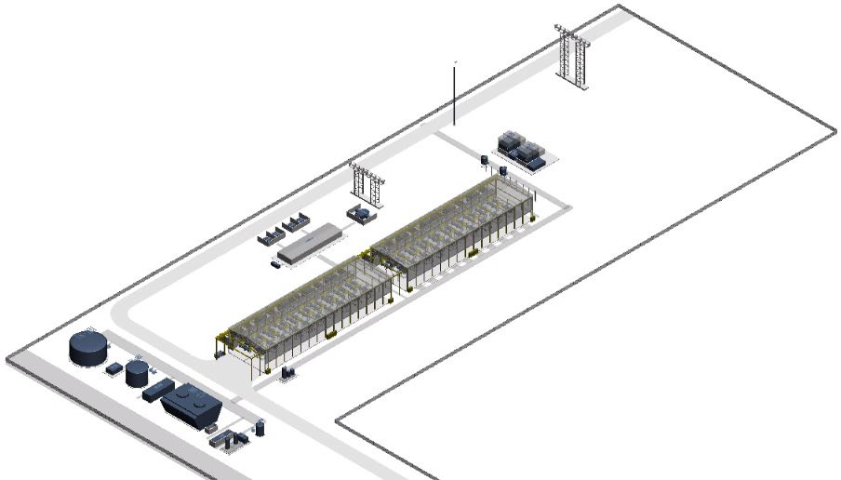
Hydrogen Facility: Plant Overview (4 TPH / 220 MW)
High Voltage Supply Lines
Hydrogen Vent Stack
Main Transformers
Hydrogen Compressors
Electrical Building
Raw Water Storage Tank
Security Perimeter
Electrolyzer Buildings
Fence
Instrument Air Compressor
Demineralized Water Storage & Treatment System
KOH Tank/Pump
Cooling Tower

Slide 22
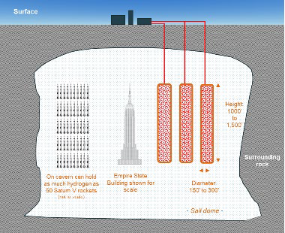
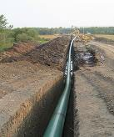
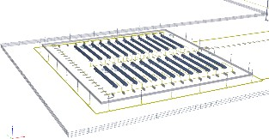
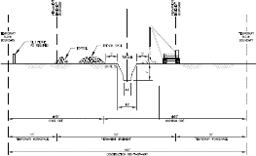
Proven Hydrogen Storage Methods
¹ “Discharge” capability based on hydrogen GTCC ²Assumes ~3,000 psig to 800 psig working gas ³Assumes 500+MW H2-GTCC @ 100% H2 operation ⁴Assumes 500+MW H2-GTCC @ 30% H2 operation
Salt Cavern
Hydrogen Pipeline Pack
Pressurized Vessels
Per 1 Cavern Stats
Per 10-mile Stats
Per 10-Vessel Stats
>100,000 MWh¹
5,500 tonnes² H₂
10 days³ to 1 month⁴
>1,000 MWh¹
38 tonnes² H₂
2 hours³ to 16 hours⁴
>200 MWh¹
8 tonnes² H₂
0.5 hours³ to 4 hours⁴

Slide 23
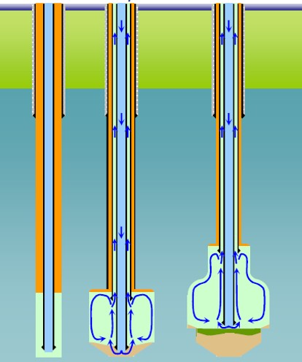
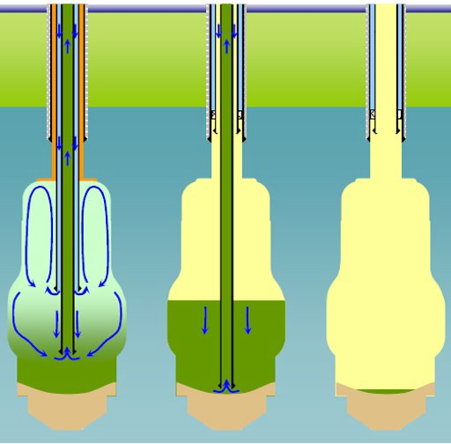
Cavern Discussion
Storage in Solution Mined Salt Caverns
Two most prevalent storage types: Depleted Reservoir and Solution-Mined Salt Cavern
Over 2,000 operating salt caverns in the US alone
Salt is the perfect storage medium
Very strong with a compressive strength similar to concrete
Salt, at depth, is plastic and therefore “self healing”
Inert to Hydrocarbons, Hydrogen, Helium, and other industrial gasses and fluids.
Salt storage is very cost competitive
Caverns can be sized to fit need
Typical equipment and process flows are illustrated.
Nitrogen blanket protects cavern roof and allows for roof shaping.
Water is injected in inner string, brine produced from 13-3/8” x 8-5/8” annulus (direct mining)
Flow, salinity and temperature of produced brine are measured on a daily frequency, at a minimum. Brine sampling and analyses also occurs on a weekly basis.
— Allows for tracking of cavern development (both volume and shape) when benchmarked against model.
After about 1/3 of final cavern volume has been mined, flow switched to water injection into annulus and brine produced from 8-5/8” (reverse mining).
Leaching Sump
Leaching Direct
Drilling
Blanket Water Brine
Saturated Brine Insolubles
Gas
Leaching Reverse
Gas Filling
Gas Operations

Slide 24
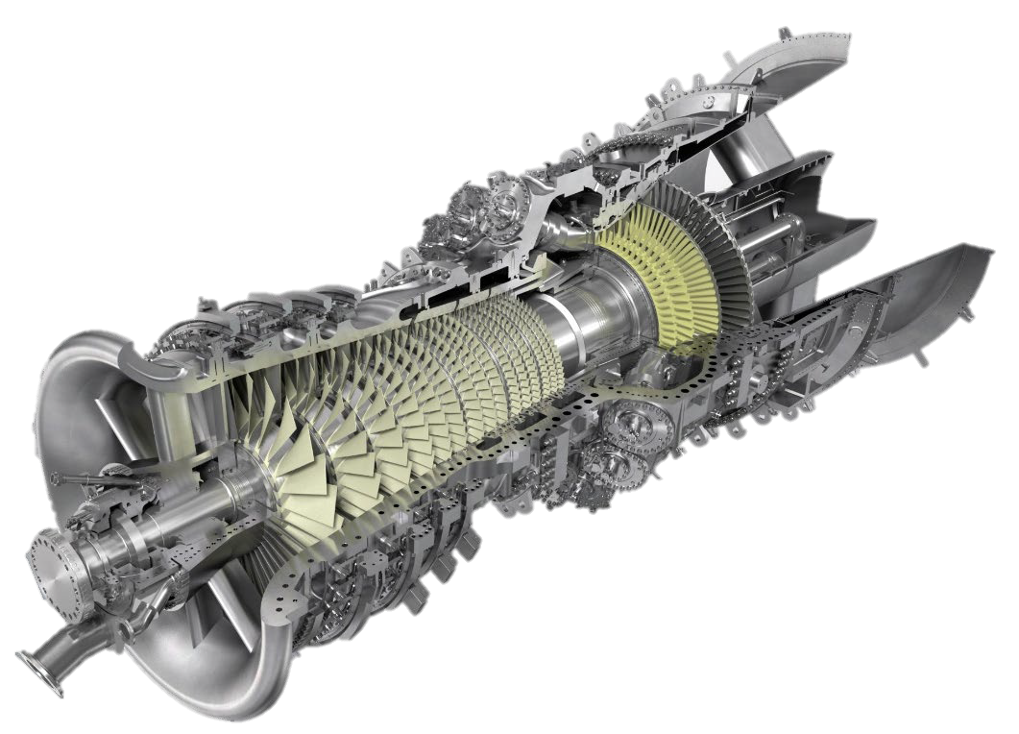
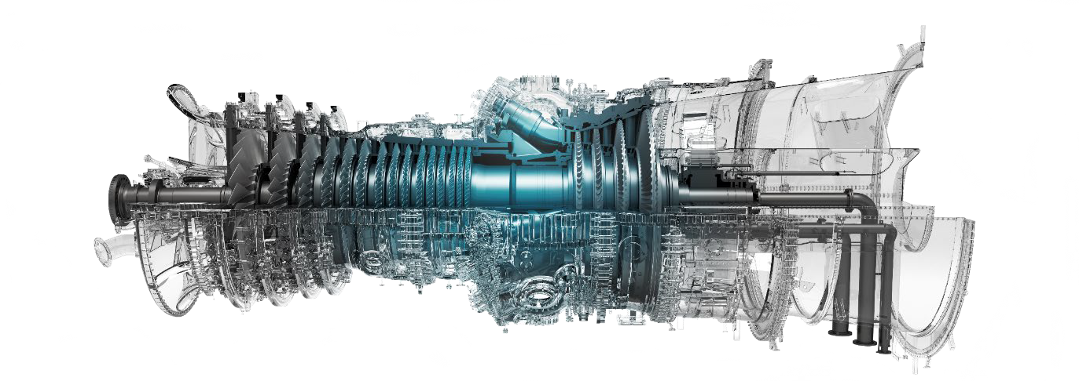
Gas Turbine Modifications Required for Hydrogen Power
ADVANCED TECHNOLOGY
H₂ GAS TURBINE
Mitsubishi Power J-Series
Output | 435MW (60Hz)
CCGT Efficiency | ~65%
Reliability | 99.6%
Units in Commercial Operation | 45
Modifications are only required on the combustion components of the GT

Slide 25
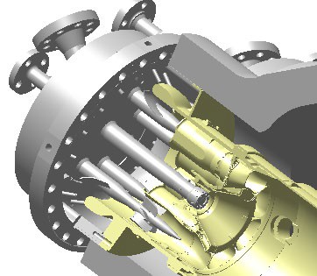
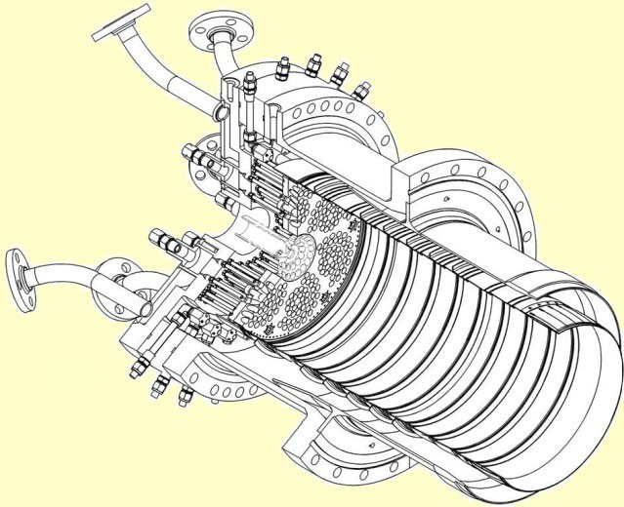
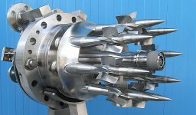
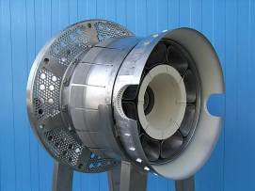
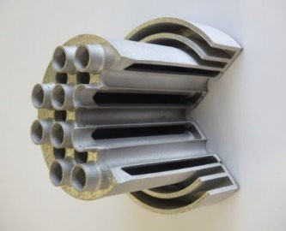
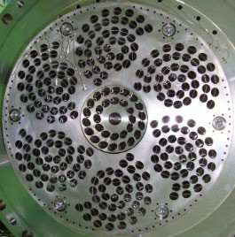
Hydrogen-Fired Gas Turbine Combustor Development
Current DLN combustor can Operate up to 30% Hydrogen
Multi-Cluster Technology Will Operate on 100% Hydrogen
3D Printed Part
Two DLN combustor technologies that can operate on hydrogen and achieve ultra-low plant emissions levels

Slide 26
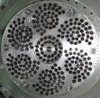
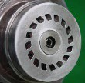
Detail Line-up of H2 Combustion Technology- All Frame sizes
Type
Low NOx Tech
H2 Content (volume %)
Schedule
F/G/GAC/J/JAC:
Diffusion
N2 dilution, Water/
Steam injection
100% (Ready)
1970
Cogen/IGCC
2027
Magnum H2 conversion
Large Frame Gas Turbines
Ready
F/G/GAC/J/JAC:
Pre-Mix (DLN)
Dry
1982
DLN
2018
30% co-firing test completed
2024
30% co-firing verification @T-point2
30% (Ready)
Under development
F/G/GAC/J/JAC:
Multi-Cluster (DLN)
Dry
100% (Target)
2025
Validation Completion
Ready
H-25:
Diffusion
Water/ Steam injection
100%
1990
Middle & Small Gas Turbines
Under development
Dry
30% (Ready)
2016
2019
30% co-firing
2022
60% co-firing
H-25:
Multi-Cluster (DLN)
Product
development
test completed
Validation
completed Completion
Dry
100% (Target)
2023
100% firing Validation Completion
Ready
H-100:
Pre-Mix (DLN)
H-100:
Dry
30% (Ready)
Product
2017 2018
30% co-firing
development completed
Test completed
Under Develop- ment
Multi-Cluster (DLN)
Dry
2017
IGCC
In the late 2020’s Validation Completion
100% (Target)
Mitsubishi Power, Ltd. All Rights Reserved.
25

Slide 27
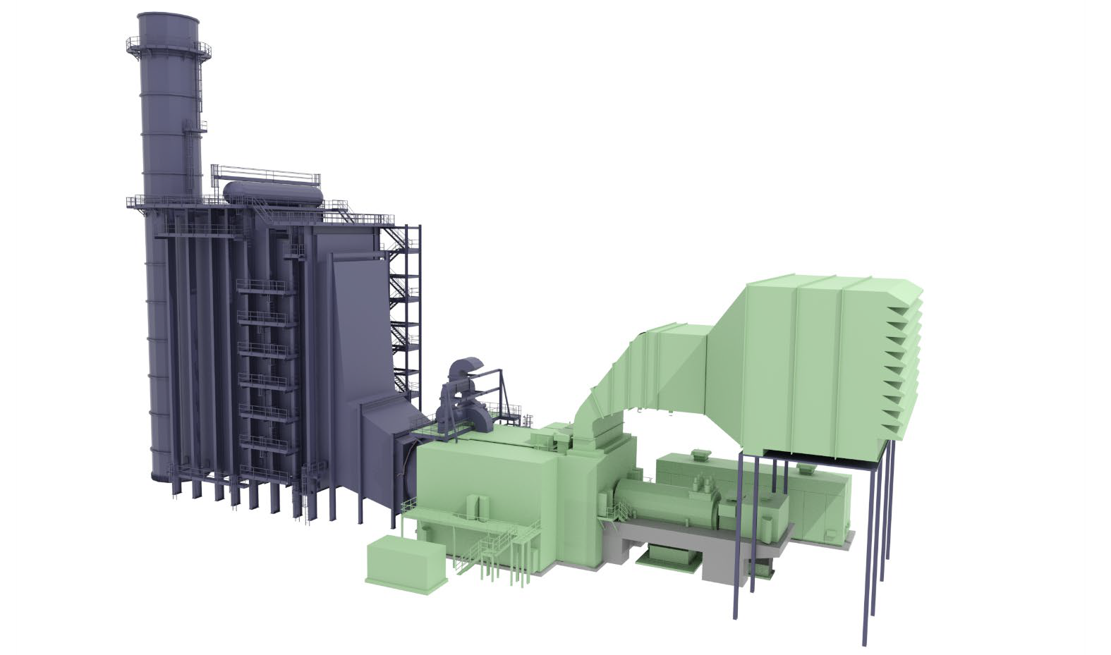
100% Hydrogen Utilization – GTCC System Modifications
Minor modifications / enhancements / hardware additions to achieve 100% Hydrogen Utilization
GAS TURBINE & AUXILERY MODIFICATIONS
HRSG & SCR
Combustion system
Larger enclosure, area classification & ventilation
Larger fuel gas pipes, components & material changes
Fuel system explosion proof instruments
Control system enhancement
Additional hazardous gas detection equipment
Fire protection
Potential catalyst improvement
AIR INLET FILTER HOUSE
GENERATOR
FOUNDATIONS
Longer HRSG Foundation
Larger GT Enclosure Foundation
Additional Minor pads for Fuel Mixing, etc.
ADDED FUEL MIXING EQUIPMENT
Flow meters for hydrogen and natural gas
Redundant calorie meters
Hydrogen and natural gas mixer
Hazardous gas detection equipment
Gas Chromatograph

Slide 28
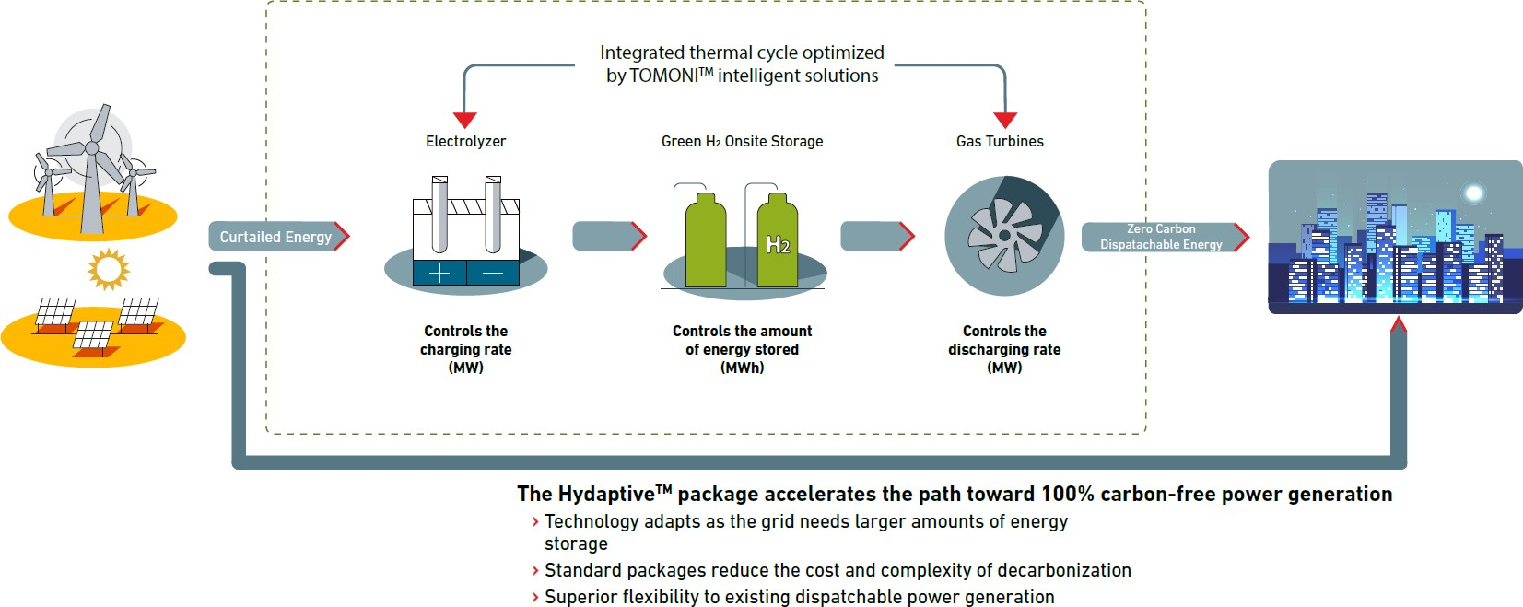
Mitsubishi Power Hydaptive™ Standard Flexibility Package

Slide 29
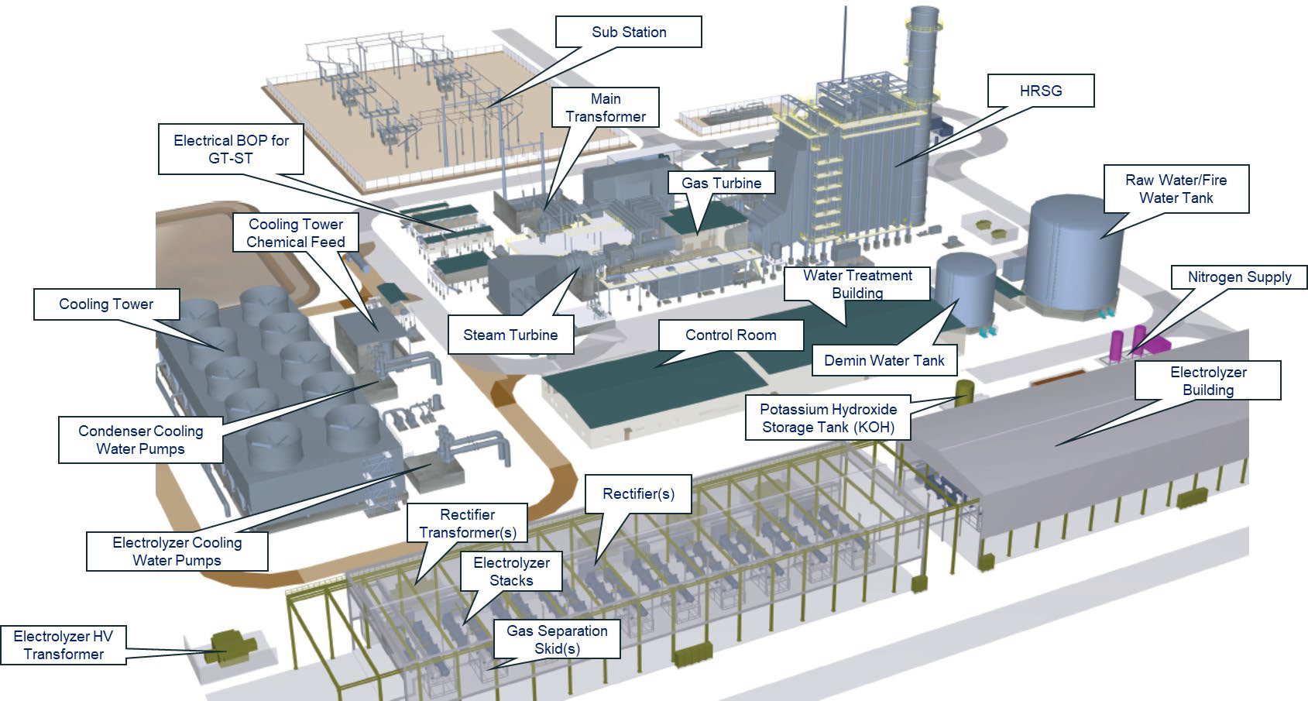
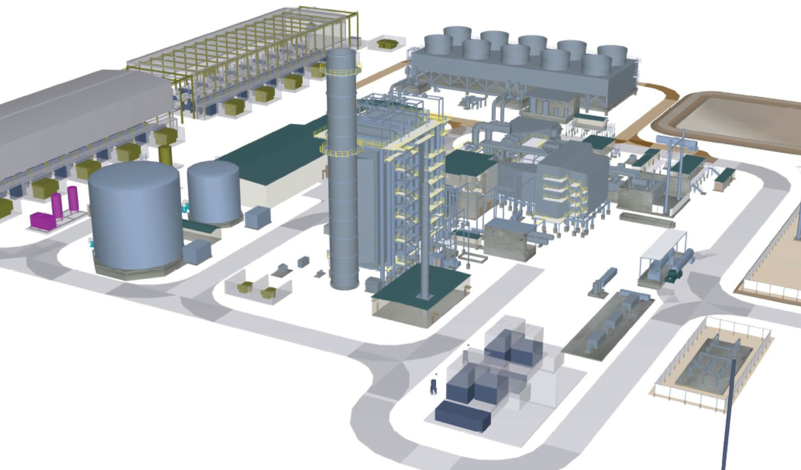
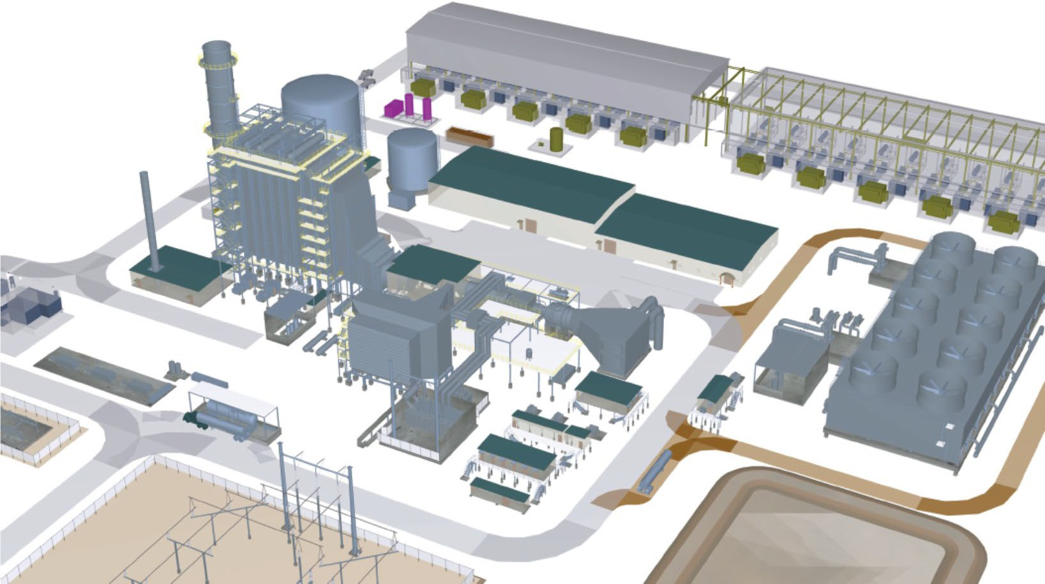
Fully Integrated Hydaptive Storage System
Seamless integration across the “charging” cycle (electrolyzers) and “discharging” cycle (hydrogen GT/GTCC) with on- or off-site H₂ storage

Slide 30
Key Takeaways from Today
Green hydrogen is not a power generation fuel, it is an energy storage medium
The processes and equipment needed to generate and store hydrogen is all mature technology
The evolution of H2 combustion has been going on for decades and is on the path to reach the next plateau in this decade
Mitsubishi Power is not just considering H2-capable turbines … our focus is offering entire H2 storage ecosystem (conversion + storage + GT)

Slide 31
Questions
© 2020 Mitsubishi Power Americas, Inc. All Rights Reserved.

